Slide 1

Python For Data Analysis Master 1 1st semester - Project
Data Visualisation and Prediction relying on FastF1 Python API.
Authors : Porterie Benjamin, Touitou Yves

Slide 2

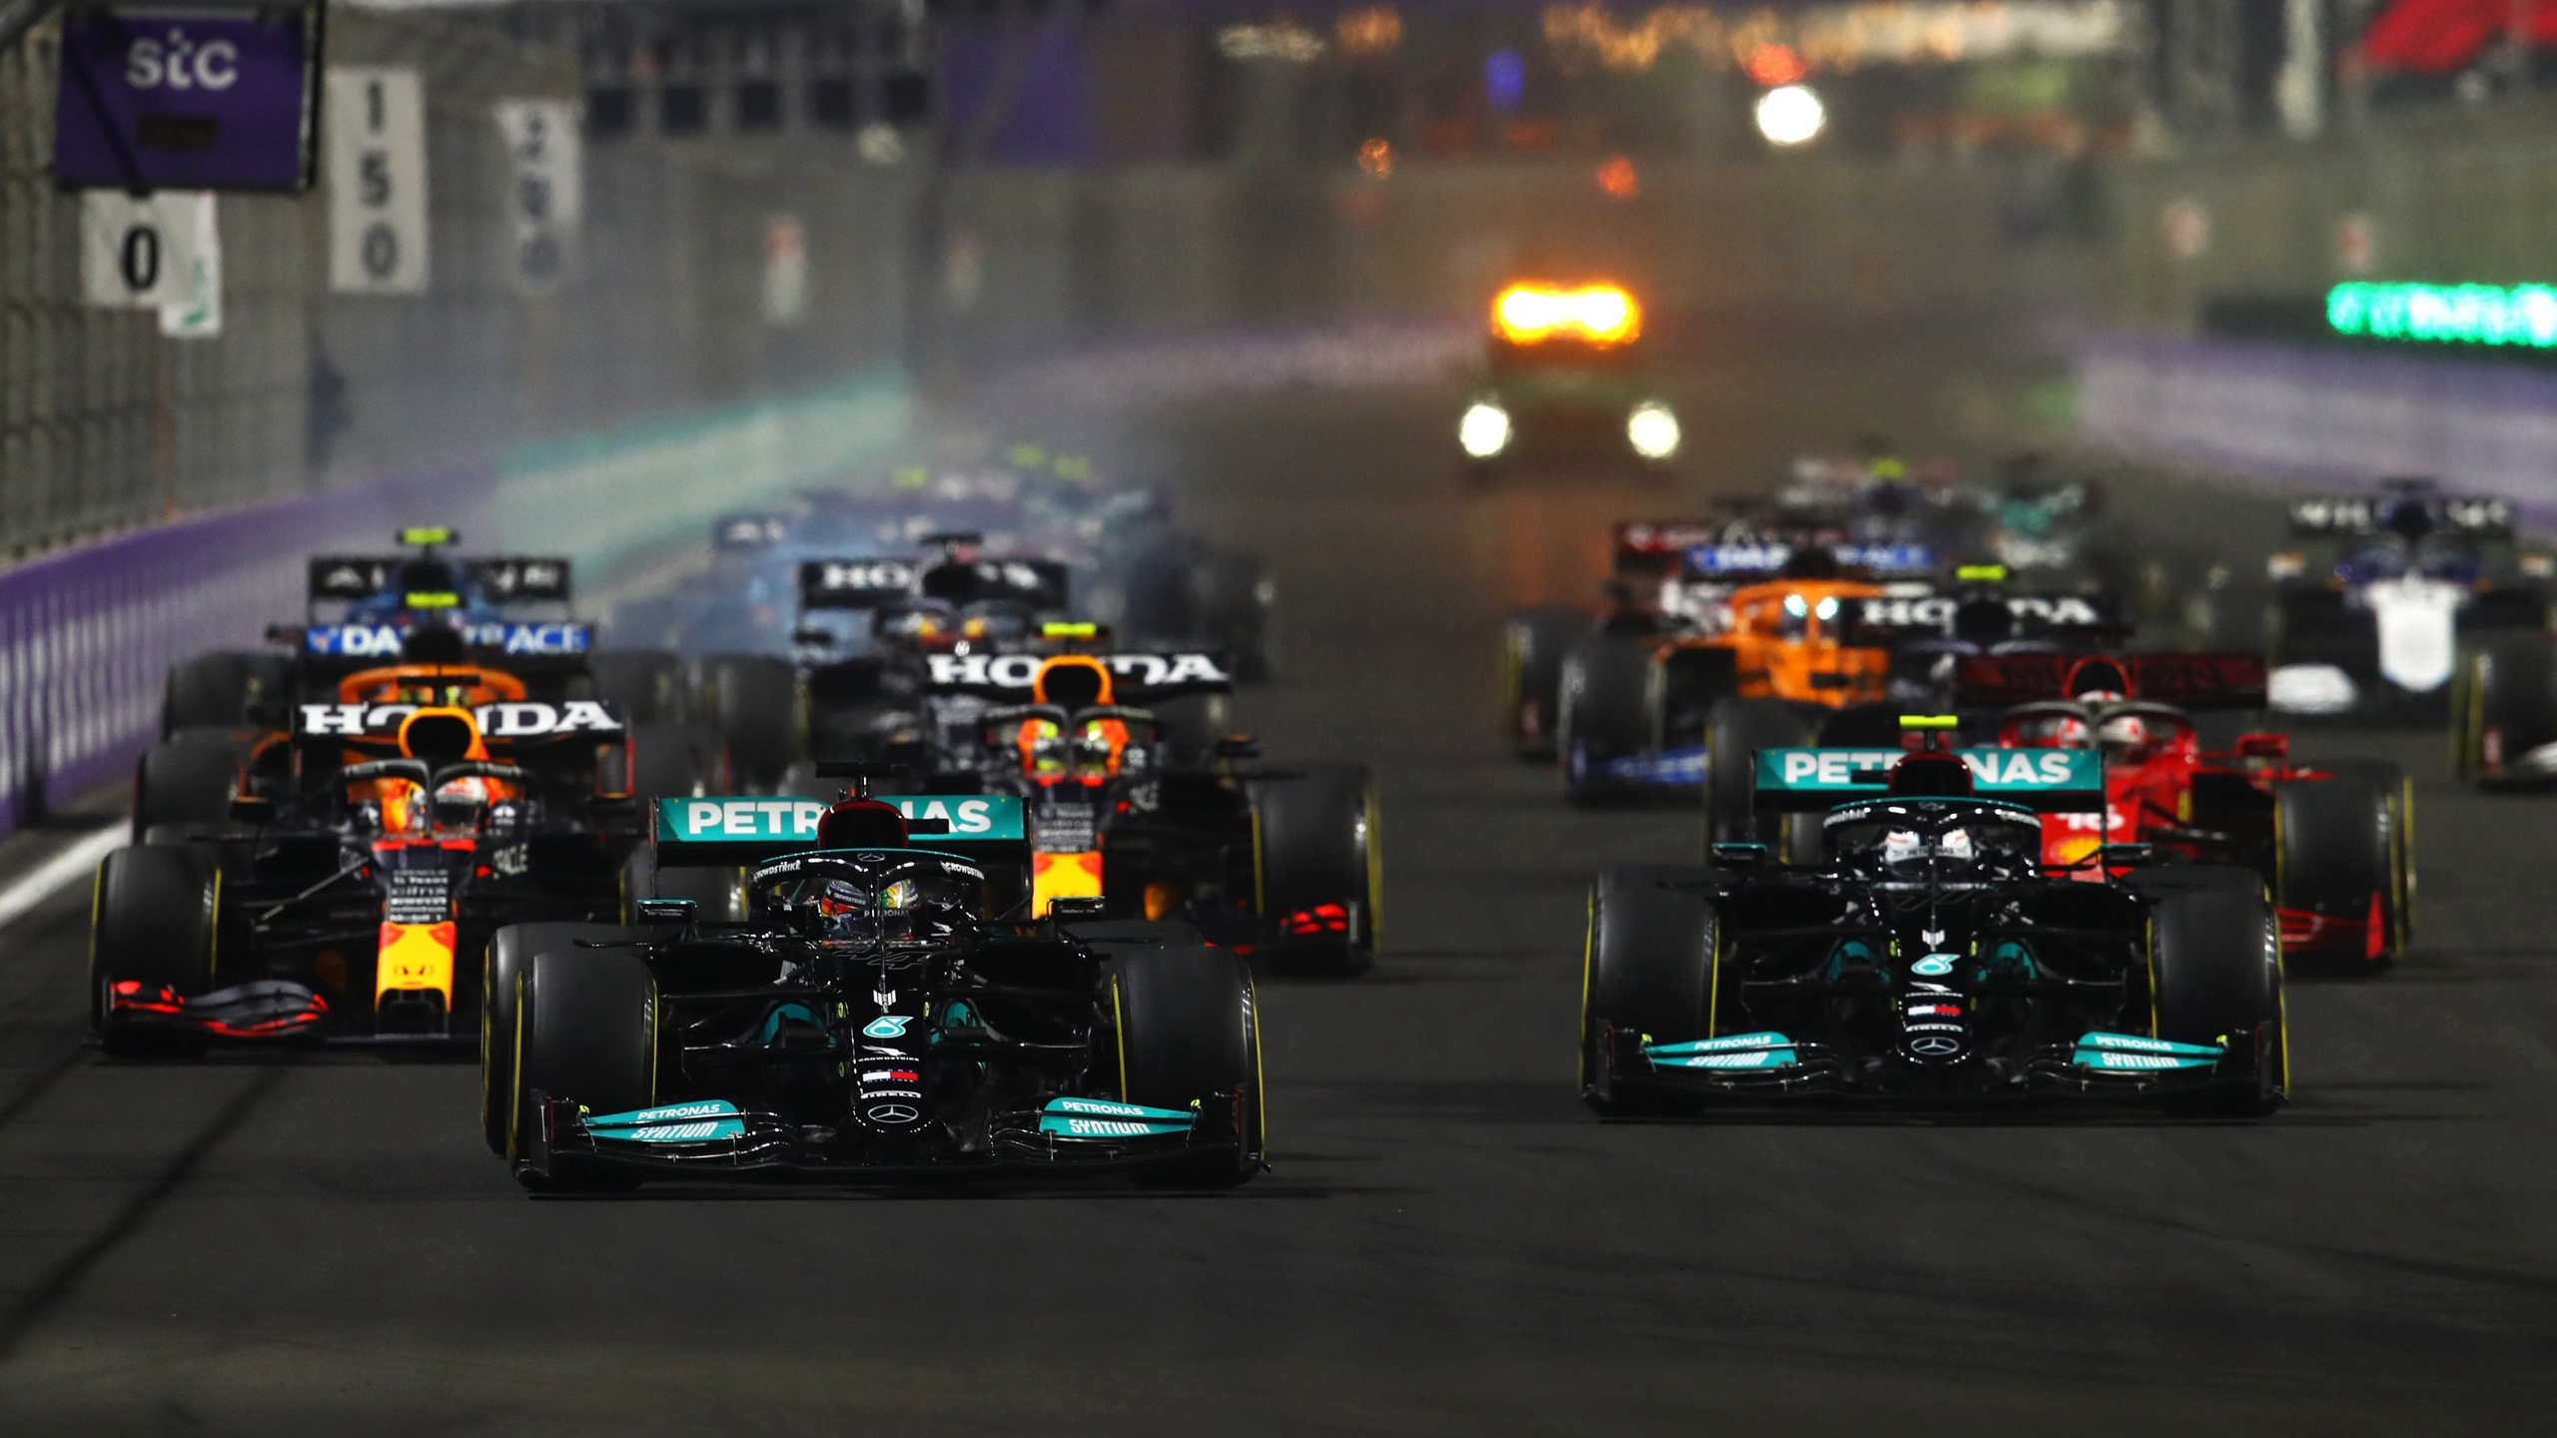

Slide 3
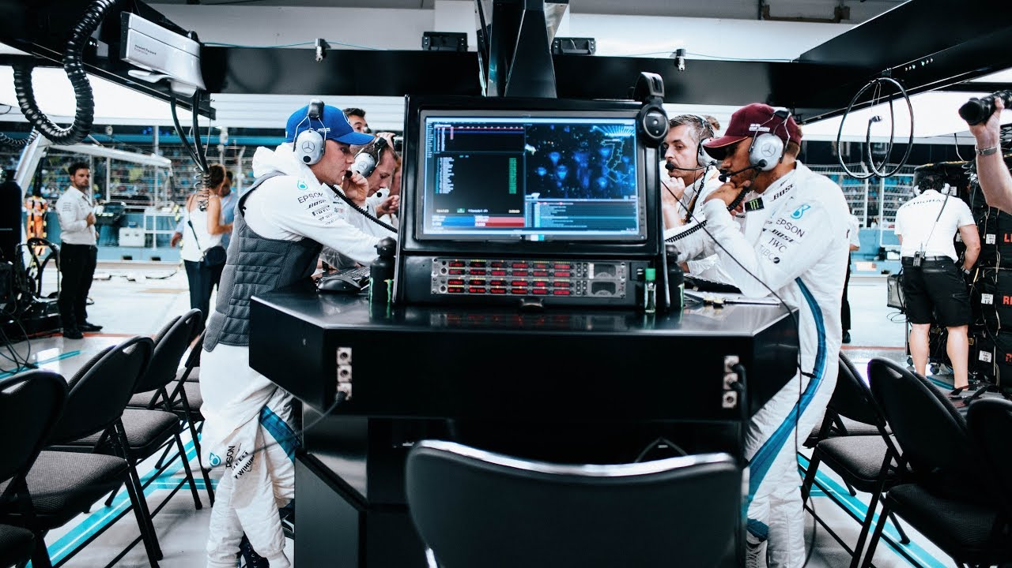
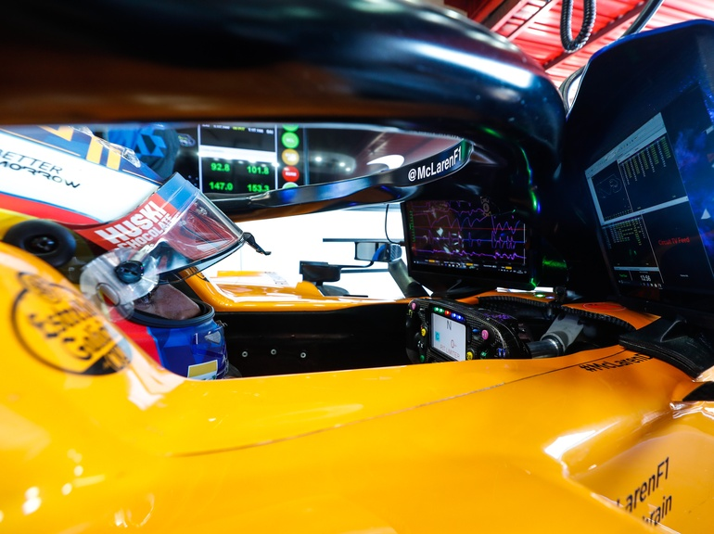
Space of Data in Formula 1
To win races, engineers follow the drivers at each circuit venue to assist them in decision making.
Those engineers on site are complementary with all the engineers back in the formula 1 team’s factory.
Throughout the weekend, even the driver invest time in data analysing to improve his driving skills until Sunday, which is race day.

Slide 4
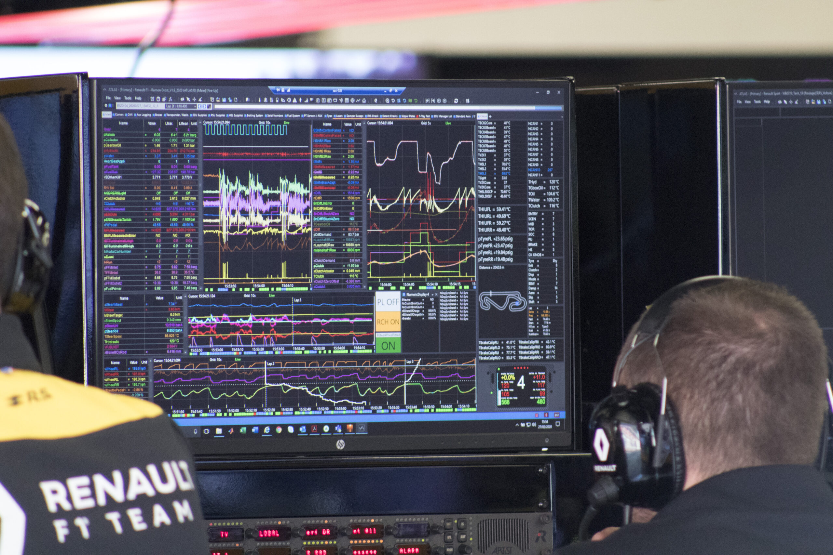
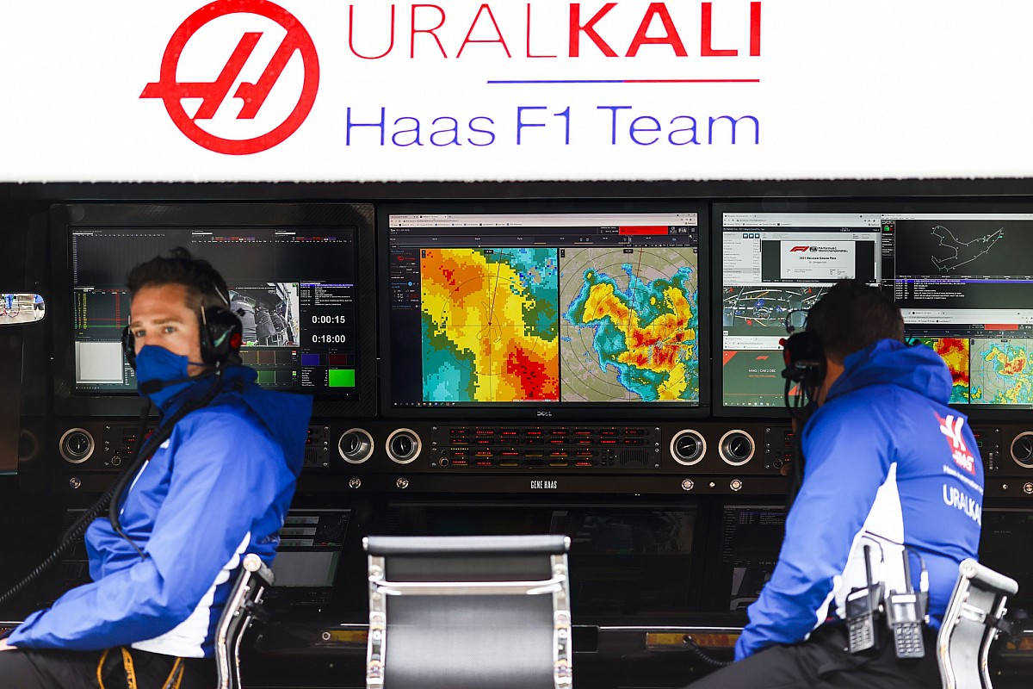
Two different sorts of Data
Internal data : everything related to the car. (Velocity, Shifting, Throttle & Brake pedals, Tyres temperature, Engine status, Gearbox status…)
External data : everything not related to the car. (Weather forecasts, Track temperature & grip condition, Track Flags, Other cars light telemetry…)

Slide 5
Fast F1 Python API
(2.1.12)

Slide 6
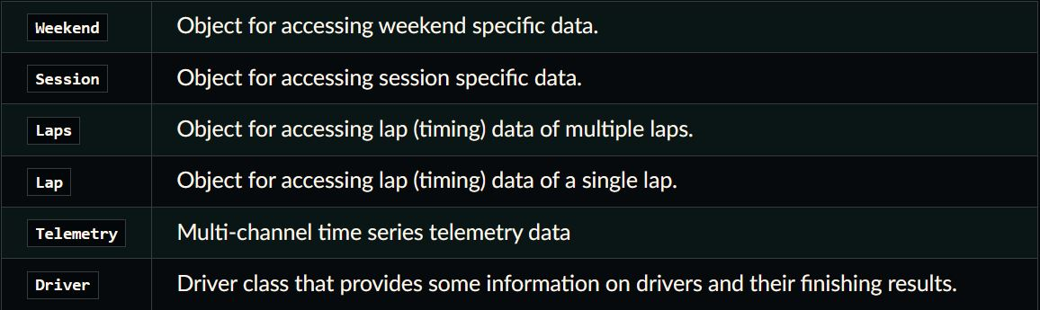
Core

Slide 7
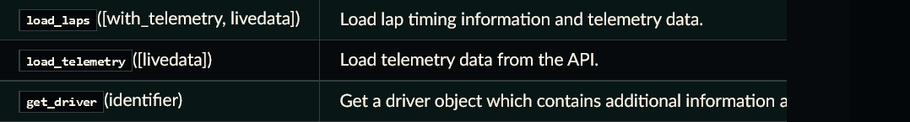
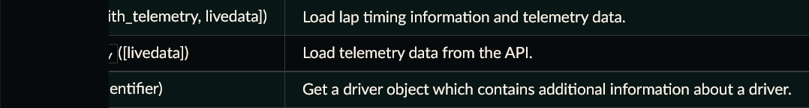
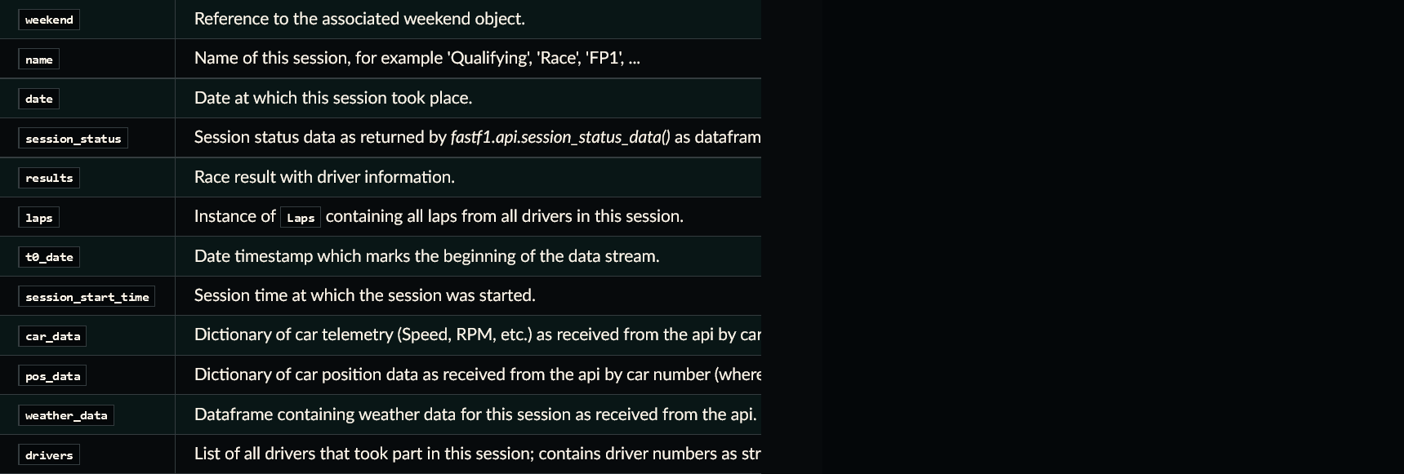
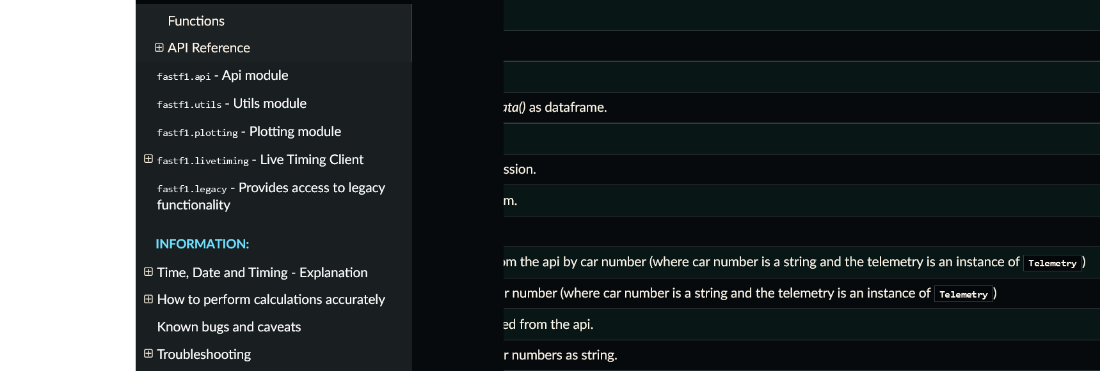
Session class
Methods
Attributes

Slide 8
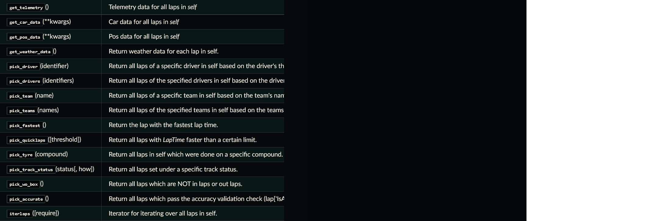
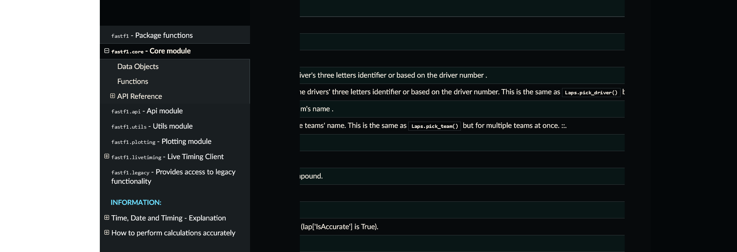
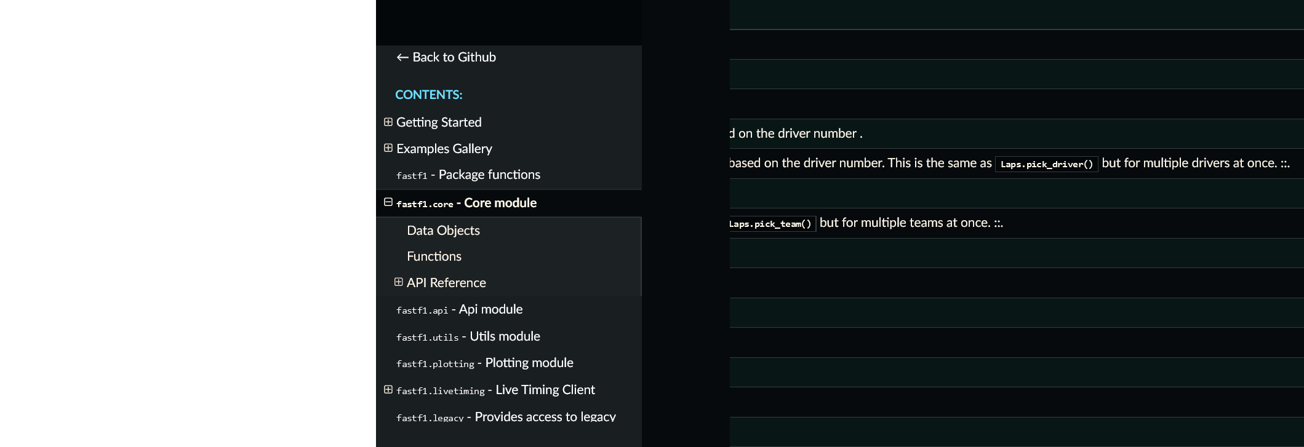
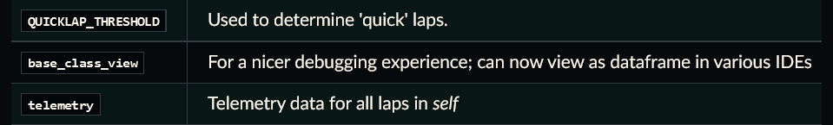
Laps class
Methods
Attributes

Slide 9
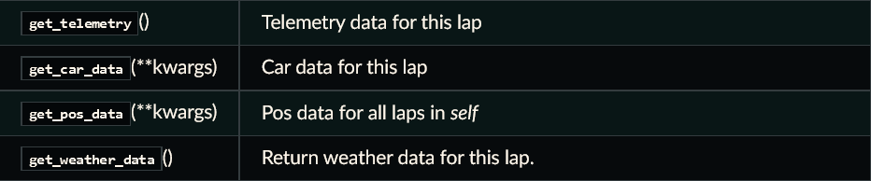
Lap class
Methods
Attributes

Slide 10
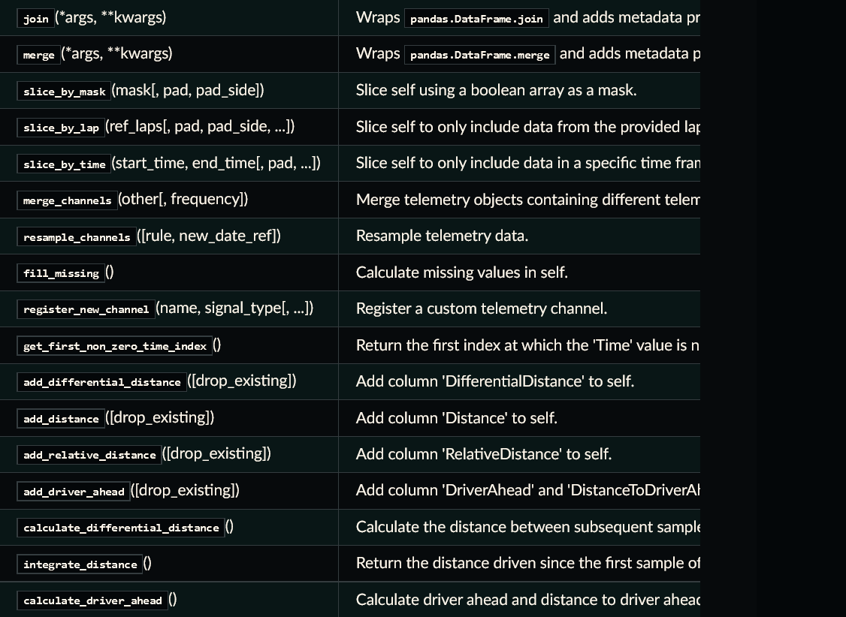
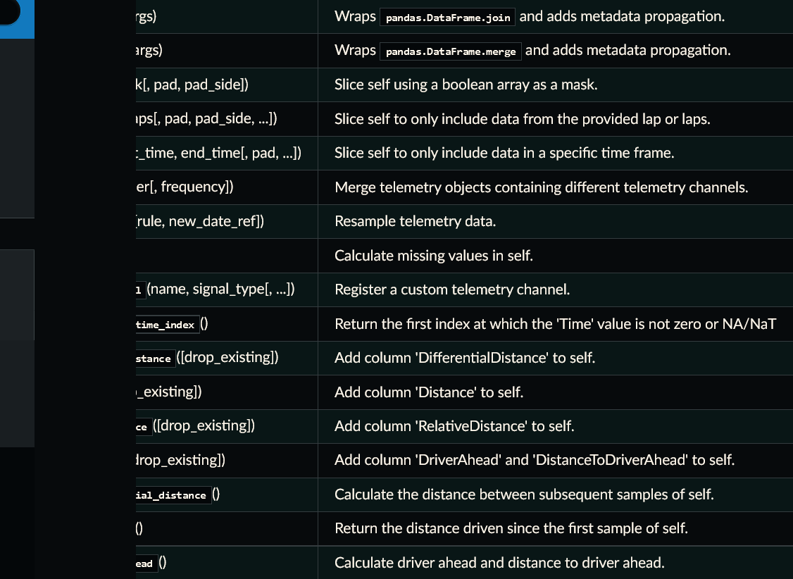
Telemetry class
Methods
Attributes

Slide 11
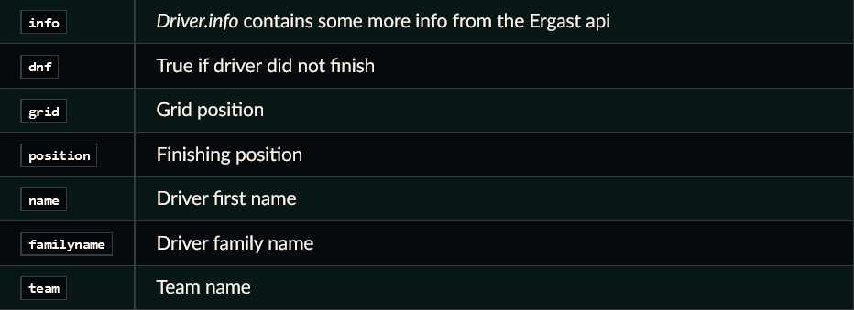
Driver class
Attributes

Slide 12
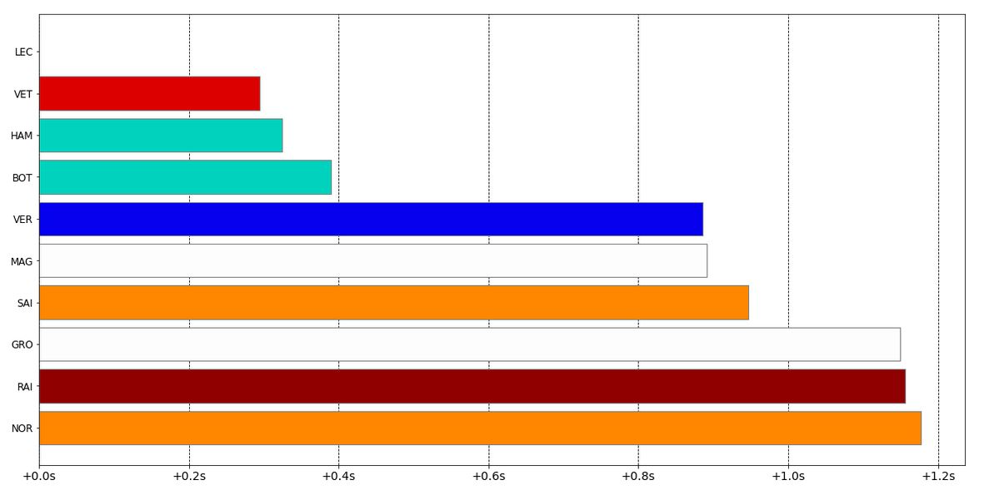
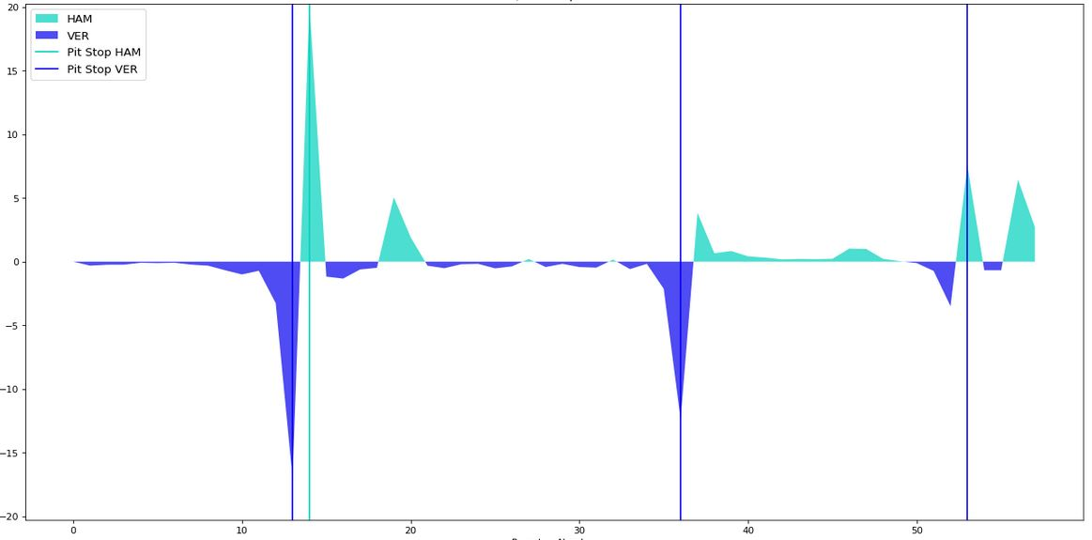
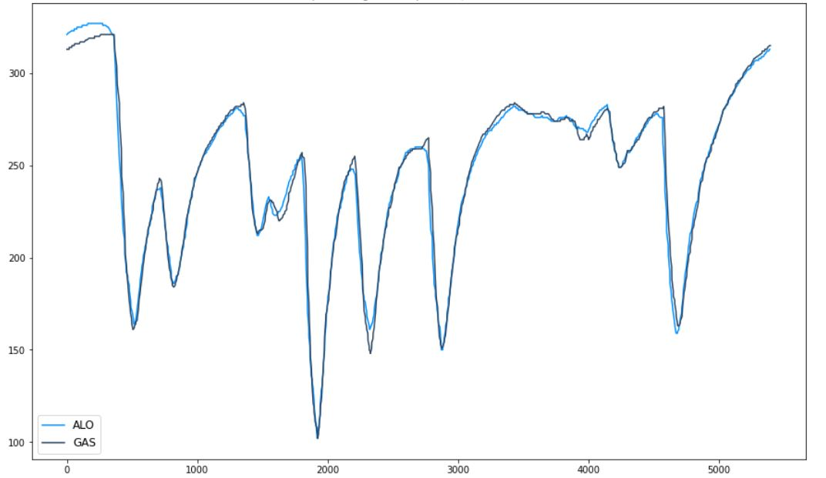
Fast F1 Data possibilities
Sessions results over the years
Session details lap by lap
F1 Cars telemetry

Slide 13

Fast F1 Data weaknesses
Data inconstancy in session laps and telemetries reports
Practices results aren’t accessible by “results” from session object and need to be retrieved by session’s laps analysis
Some practices sessions aren’t available, only 26 weekends out of 81 (between 2018 and 2021) are complete

Slide 14

Our Fast F1 notebooks
Practices_Records.ipynb
Retrieves practices sessions results by analysing the Laps object
Dataset_Creation.ipynb
Retrieves qualifications and races sessions results by analysing the Session.Results data. Then assemble practices and qualifications/races data into “allData.csv”
F1_Visualisation.ipynb
Offers multiple plot displays to have an overview of an F1 season, an F1 session or compare two drivers performance
Uses “allData.csv”, Laps and Telemetry objects
Sunday_Prediction.ipynb
Gathers all prediction models attempts, correlation and models performance graphs
1) “allData.csv” preparation for AI 2) Training, pruning and best model selection 3) Result analysis

Slide 15
allData.csv
Variable | Description
number | Driver’s car number
position | Driver’s session rank
Q1 | Qualification 1 session driver’s time
Q2 | Qualification 2 session driver’s time
Q3 | Qualification 3 session driver’s time
positionText | Driver’s session rank or ‘R’ if driver didn’t finish
points | Driver’s points collected from race day
grid | Driver’s position in race starting grid
laps | Driver’s race laps completed
status | Driver’s race end situation (Finished, Lapped, Car failure…)
year | Grand Prix’s year
gpName | Grand Prix’s name (host country)
gpNumber | Grand Prix’s number within the season
sessionName | ‘Practice’, ‘Qualifying’ or ‘Race’
driverId | Driver’s family name
code | Driver’s code (Hamilton is HAM)
DriverNationality | Driver’s Nationality
constructorId | Constructor’s name
constructorNationality | Constructor’s Nationality
fastestLapNumber | Lap number the driver’s made his best lap time within the session
fastestLapRank | Driver’s fastest lap rank
fastestLapAvgSpeed | Driver’s fastest lap’s average speed
fastestLapTime | Driver’s fastest lap time
totalTime | Driver’s time spent in session
TimeInterval | Driver’s gap behind race winner

Slide 16
Project Goal
Can we predict Sunday race results?

Slide 17
Every weekend, Formula One fans are slightly disappointed when the race ends up the way they predicted and love it when Sunday’s event gets hectic.
Can we detect reliable predictors and what are the obstacles predicting Sunday’s race result?

Slide 18
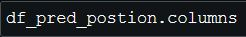
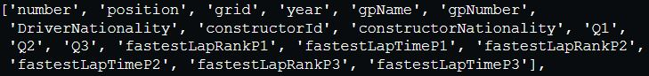
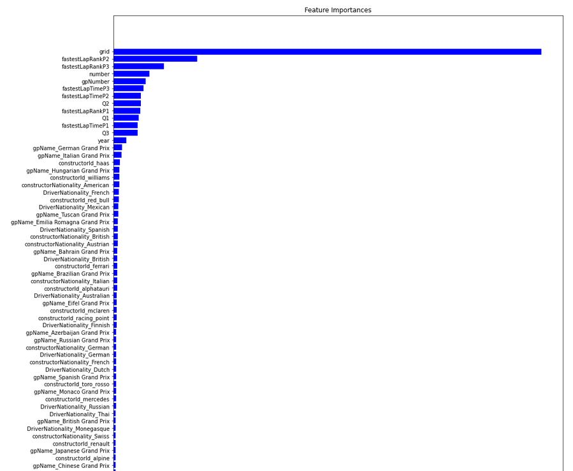
First prediction dataframe

Slide 19
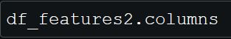
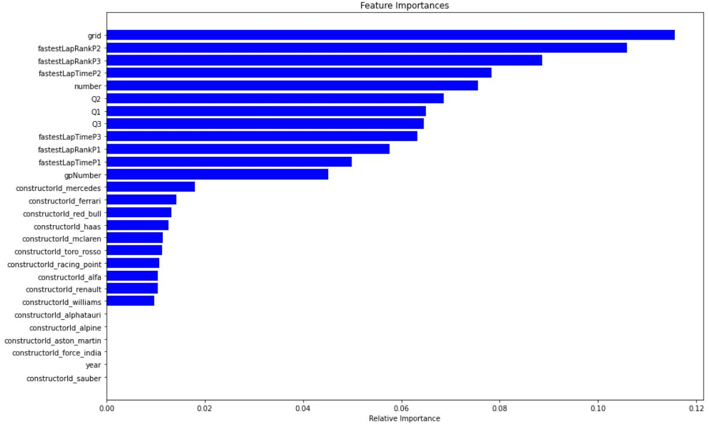
Second prediction dataframe
Insignificant variables have been dropped to lighten the predicting dataframe Variables dropped : 'DriverNationality’, 'constructorNationality’, 'gpName'

Slide 20
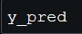
Predicted data shape
Returned data needs to be an array of positions, from 1 to the number of drivers taking part in Sunday’s race. All those positions need to be distinct.

Slide 21
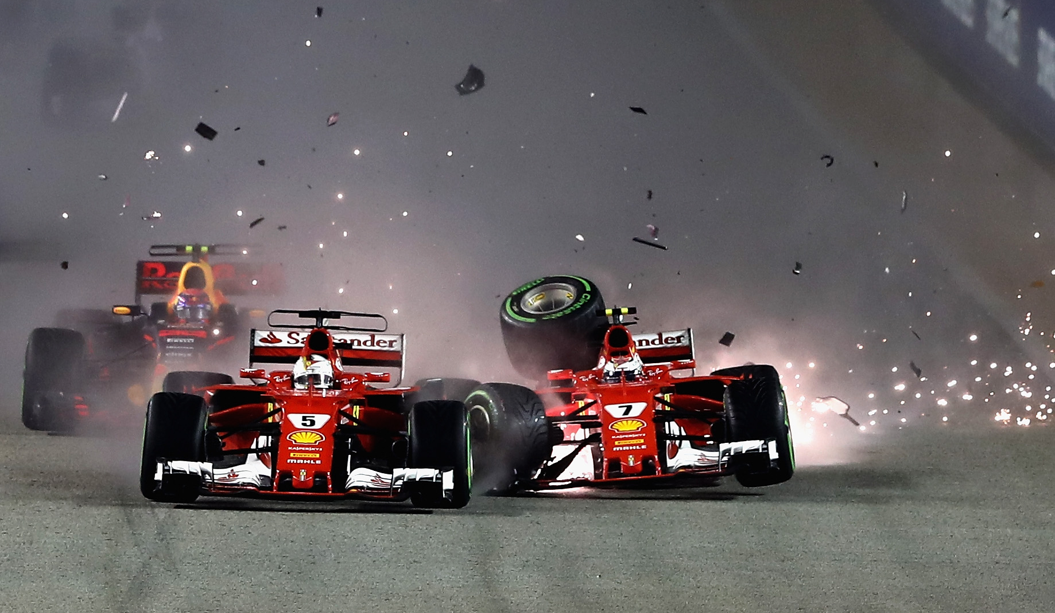
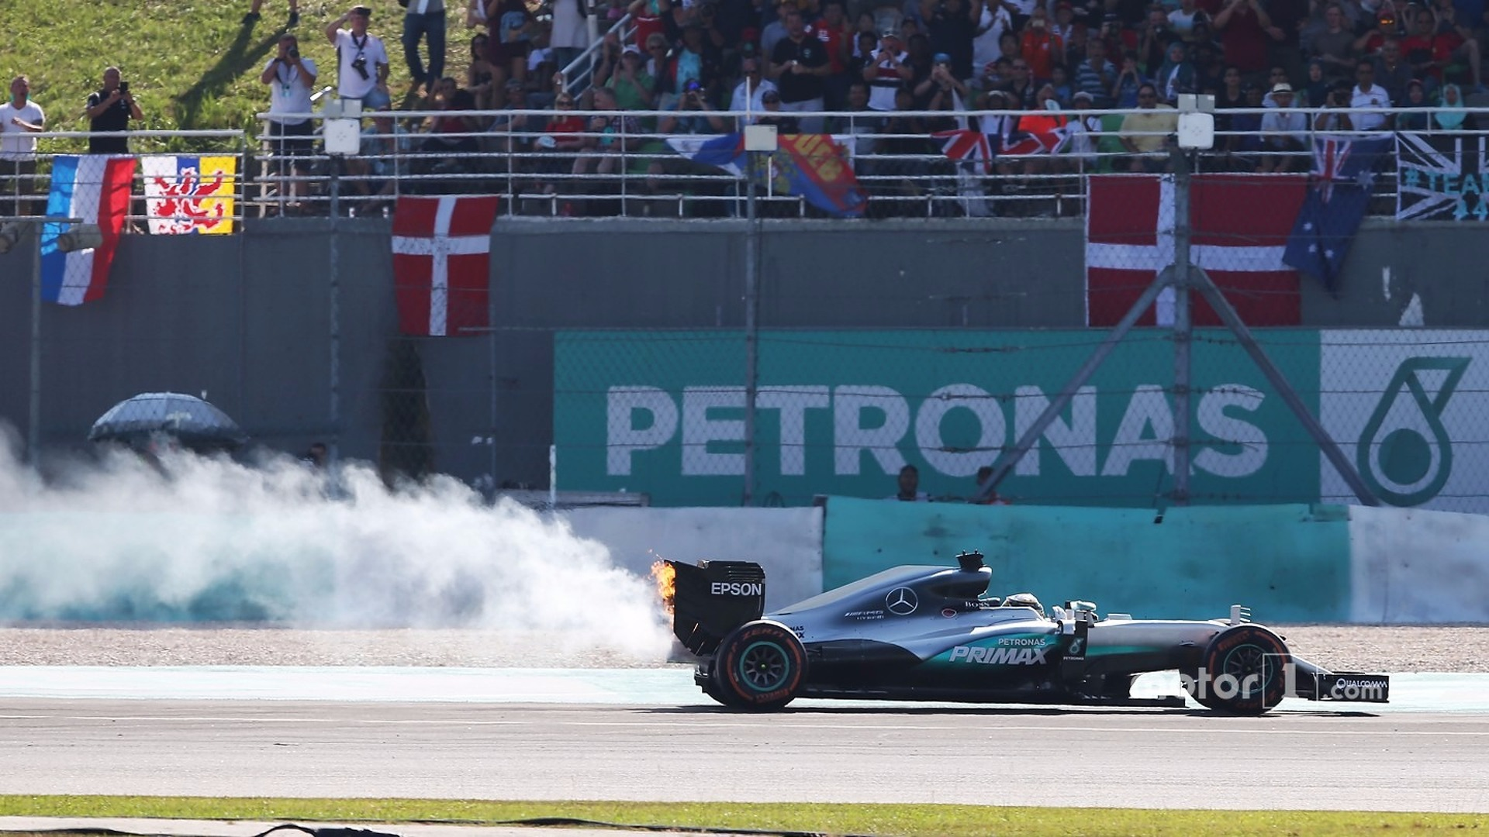
Prediction conjectural performance
Random estimation mean accuracy : 1 / Sunday’s race drivers number
Between 2018 and 2021, F1’s grid was composed of 20 drivers P_{mean} = 1/20 = 5%
On Sundays, several types of unexpected moments can completely modify the race finishing order, making it difficult to be predicted :
Contact between drivers
Contact with walls (turn misjudgement)
Car failures
Weather changes
Drivers strategy efficiency
Tyre wear higher than expected
We expect our prediction accuracy to be better than the random one but still being low because of those moments, sometimes making the race result a mess.

Slide 22
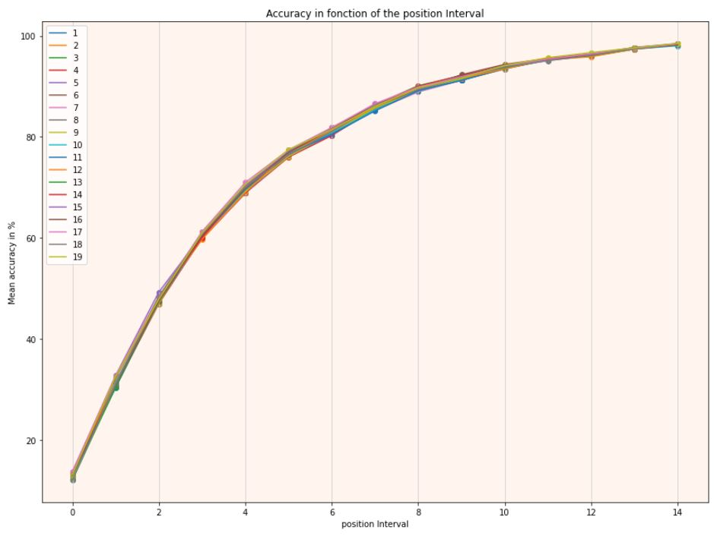
Prediction practical performance
This graph shows our models global performance with a customised prediction’s margin error (-/+).

Slide 23
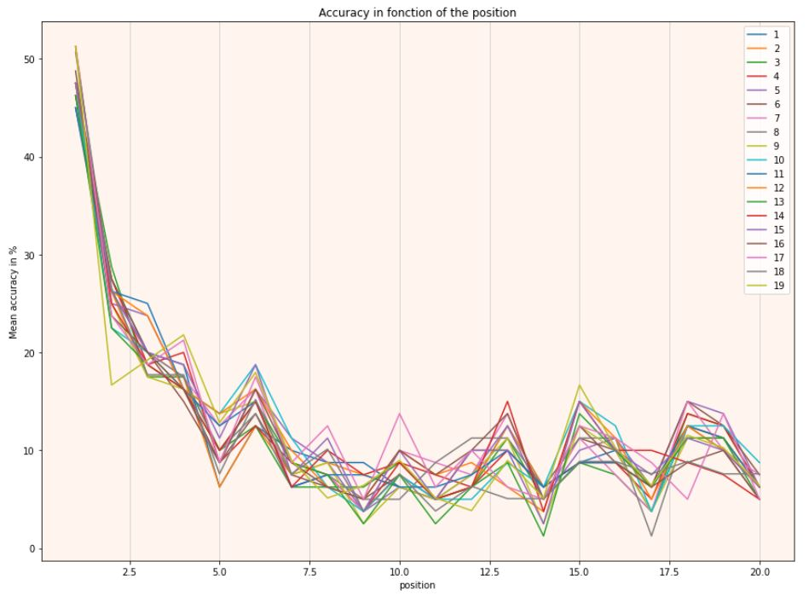
Prediction practical performance
We can observe that our models can make very good predictions concerning the first drivers and the podium. This is explained by Mercedes, Ferrari and Red Bull domination over the midfield when they were fighting for race wins throughout the last few years.

Slide 24
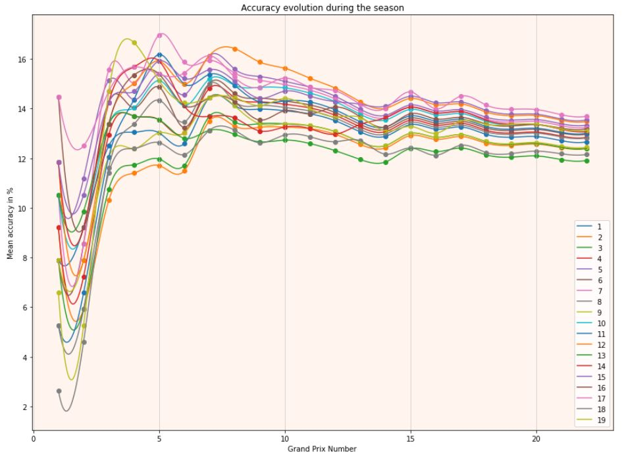
Prediction practical performance
This graph shows our models global performance as we make progress into the season. It tends to stabilize because as the season goes by, our predictive models lean on previous Grand Prix to sharpen the prediction.

Slide 25
Prediction model choice
After comparing models' accuracies, we decided to use a Random Forest Regressor, with an Output Ranking transformation.
Optimum model parameters :
Random State = 47
Number of previous weekends considered = 17
Because of the nature of our problem, we must train that model for every new prediction.

Slide 26
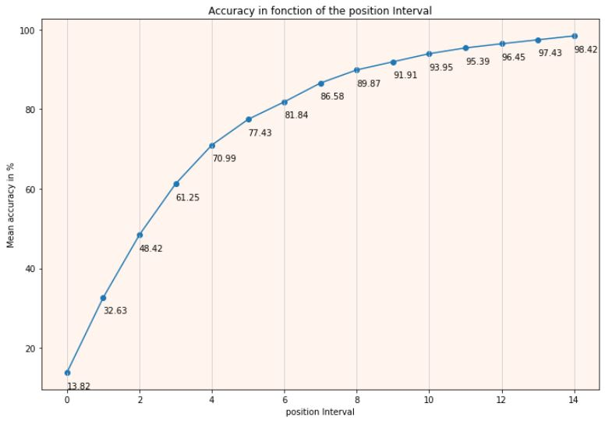
Model accuracy (position interval)

Slide 27
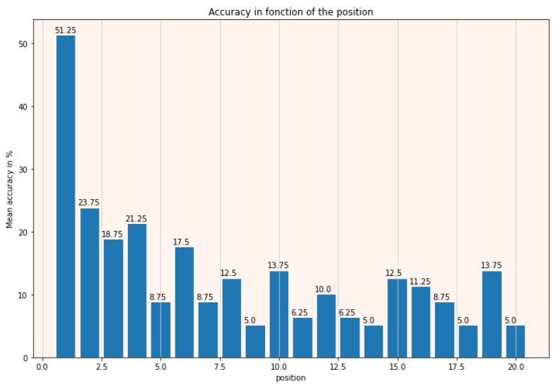
Model accuracy (function of position)

Slide 28
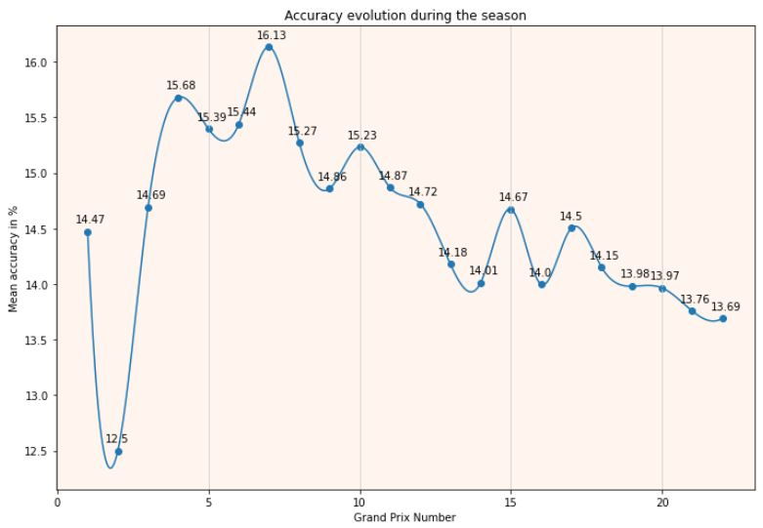
Model accuracy (over the season)

Slide 29
Appendix Weekend overview to understand each session

Slide 30
Race weekend timeline
-- Traditional Format --
-- 2021 Sprint Format --
Friday
Practice 1/2 (P1/P2)
Friday
Practice 1 (P1) Qualification (Q)
Saturday
Practice 3 (P3) Qualification (Q)
Saturday
Practice 2 (P2) Sprint Race (SR)
Sunday
Race (R)
Sunday
Race (R)

